Slide 1
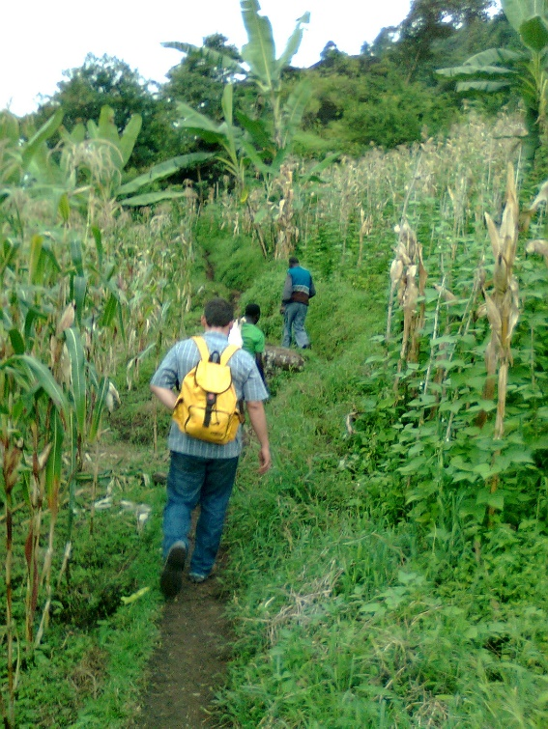
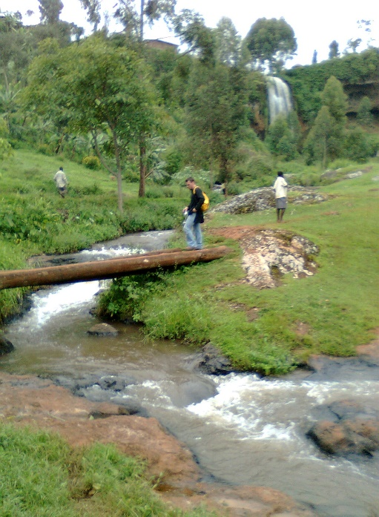
Mobilizing Messianic Youth in
Short-Term Missions

Slide 2
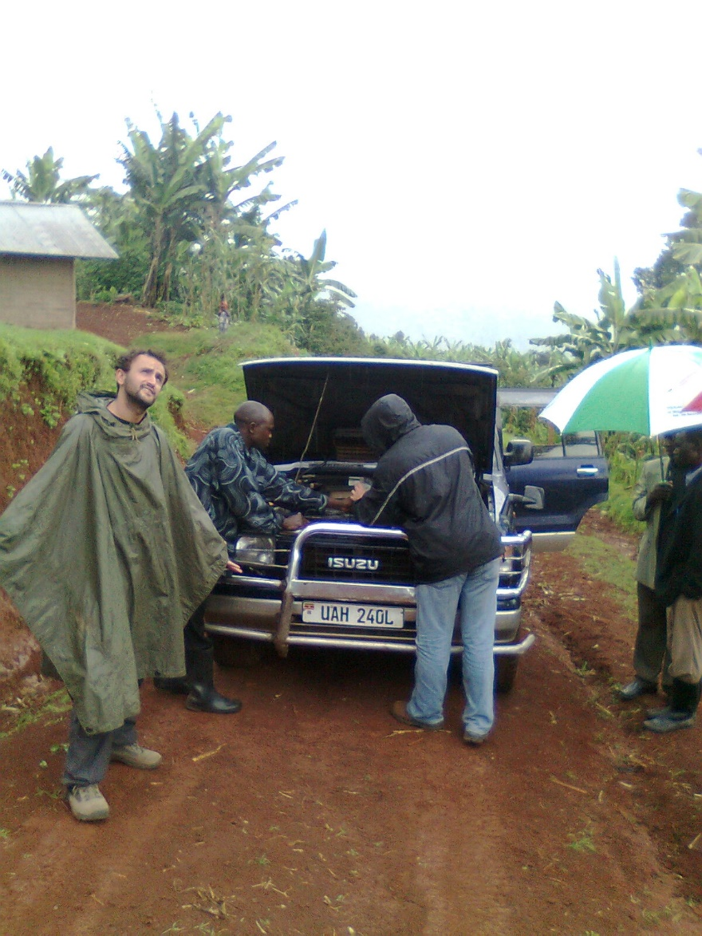
But wait…
Who is mobilizing who?

Slide 3
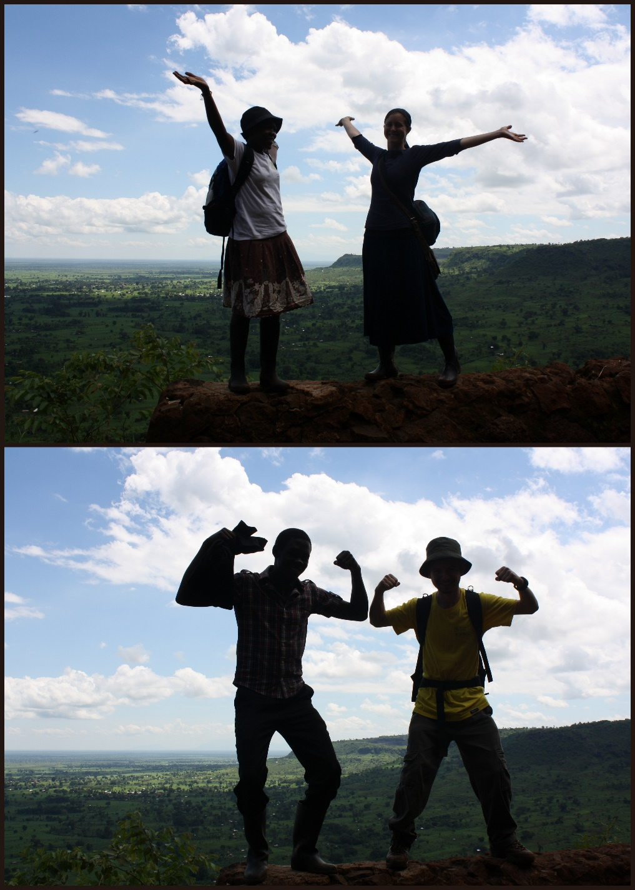
It seems to me that the youth
have the energy

Slide 4
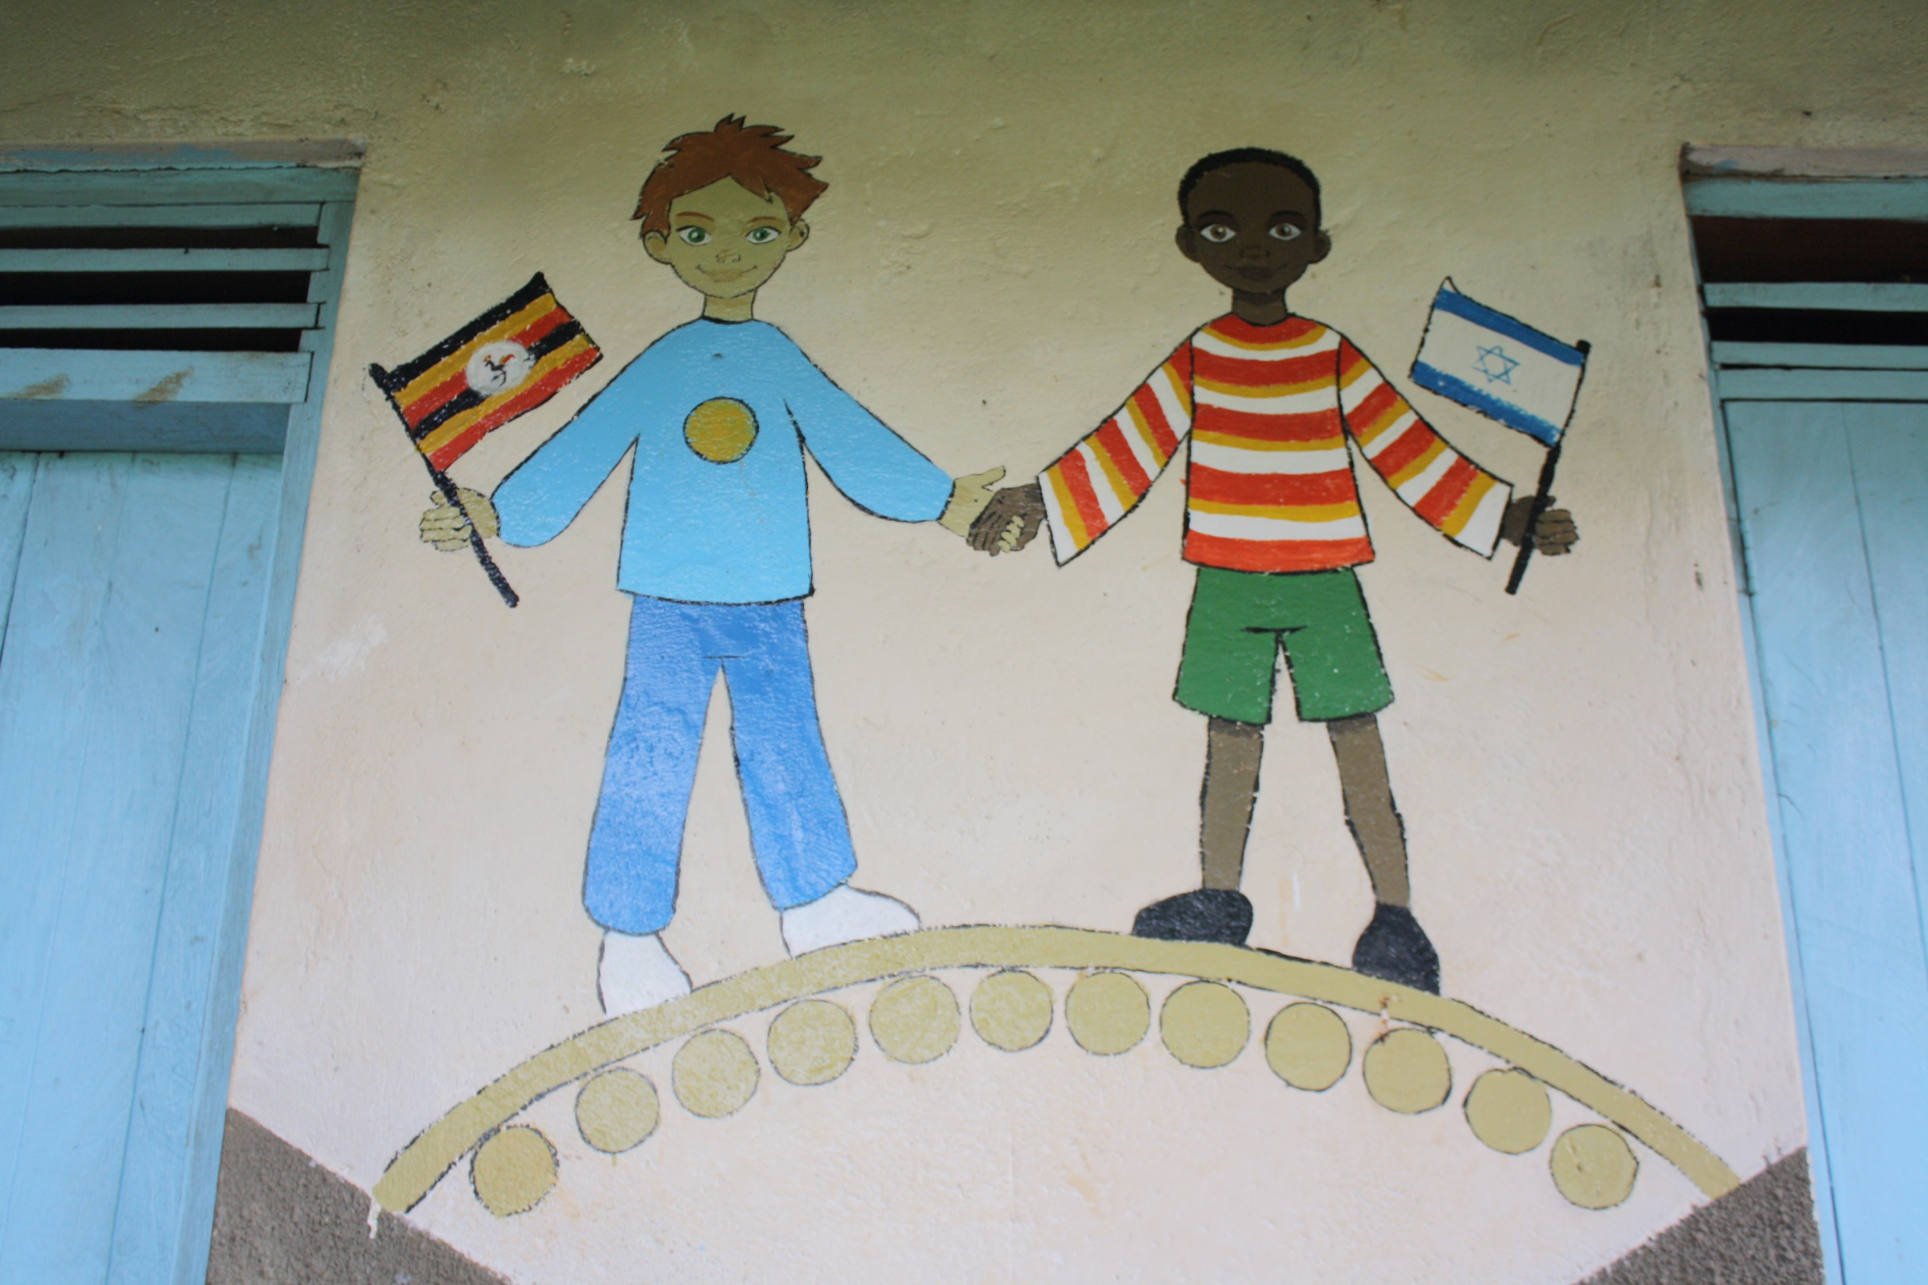
And often
The desire
The vision
And

Slide 5
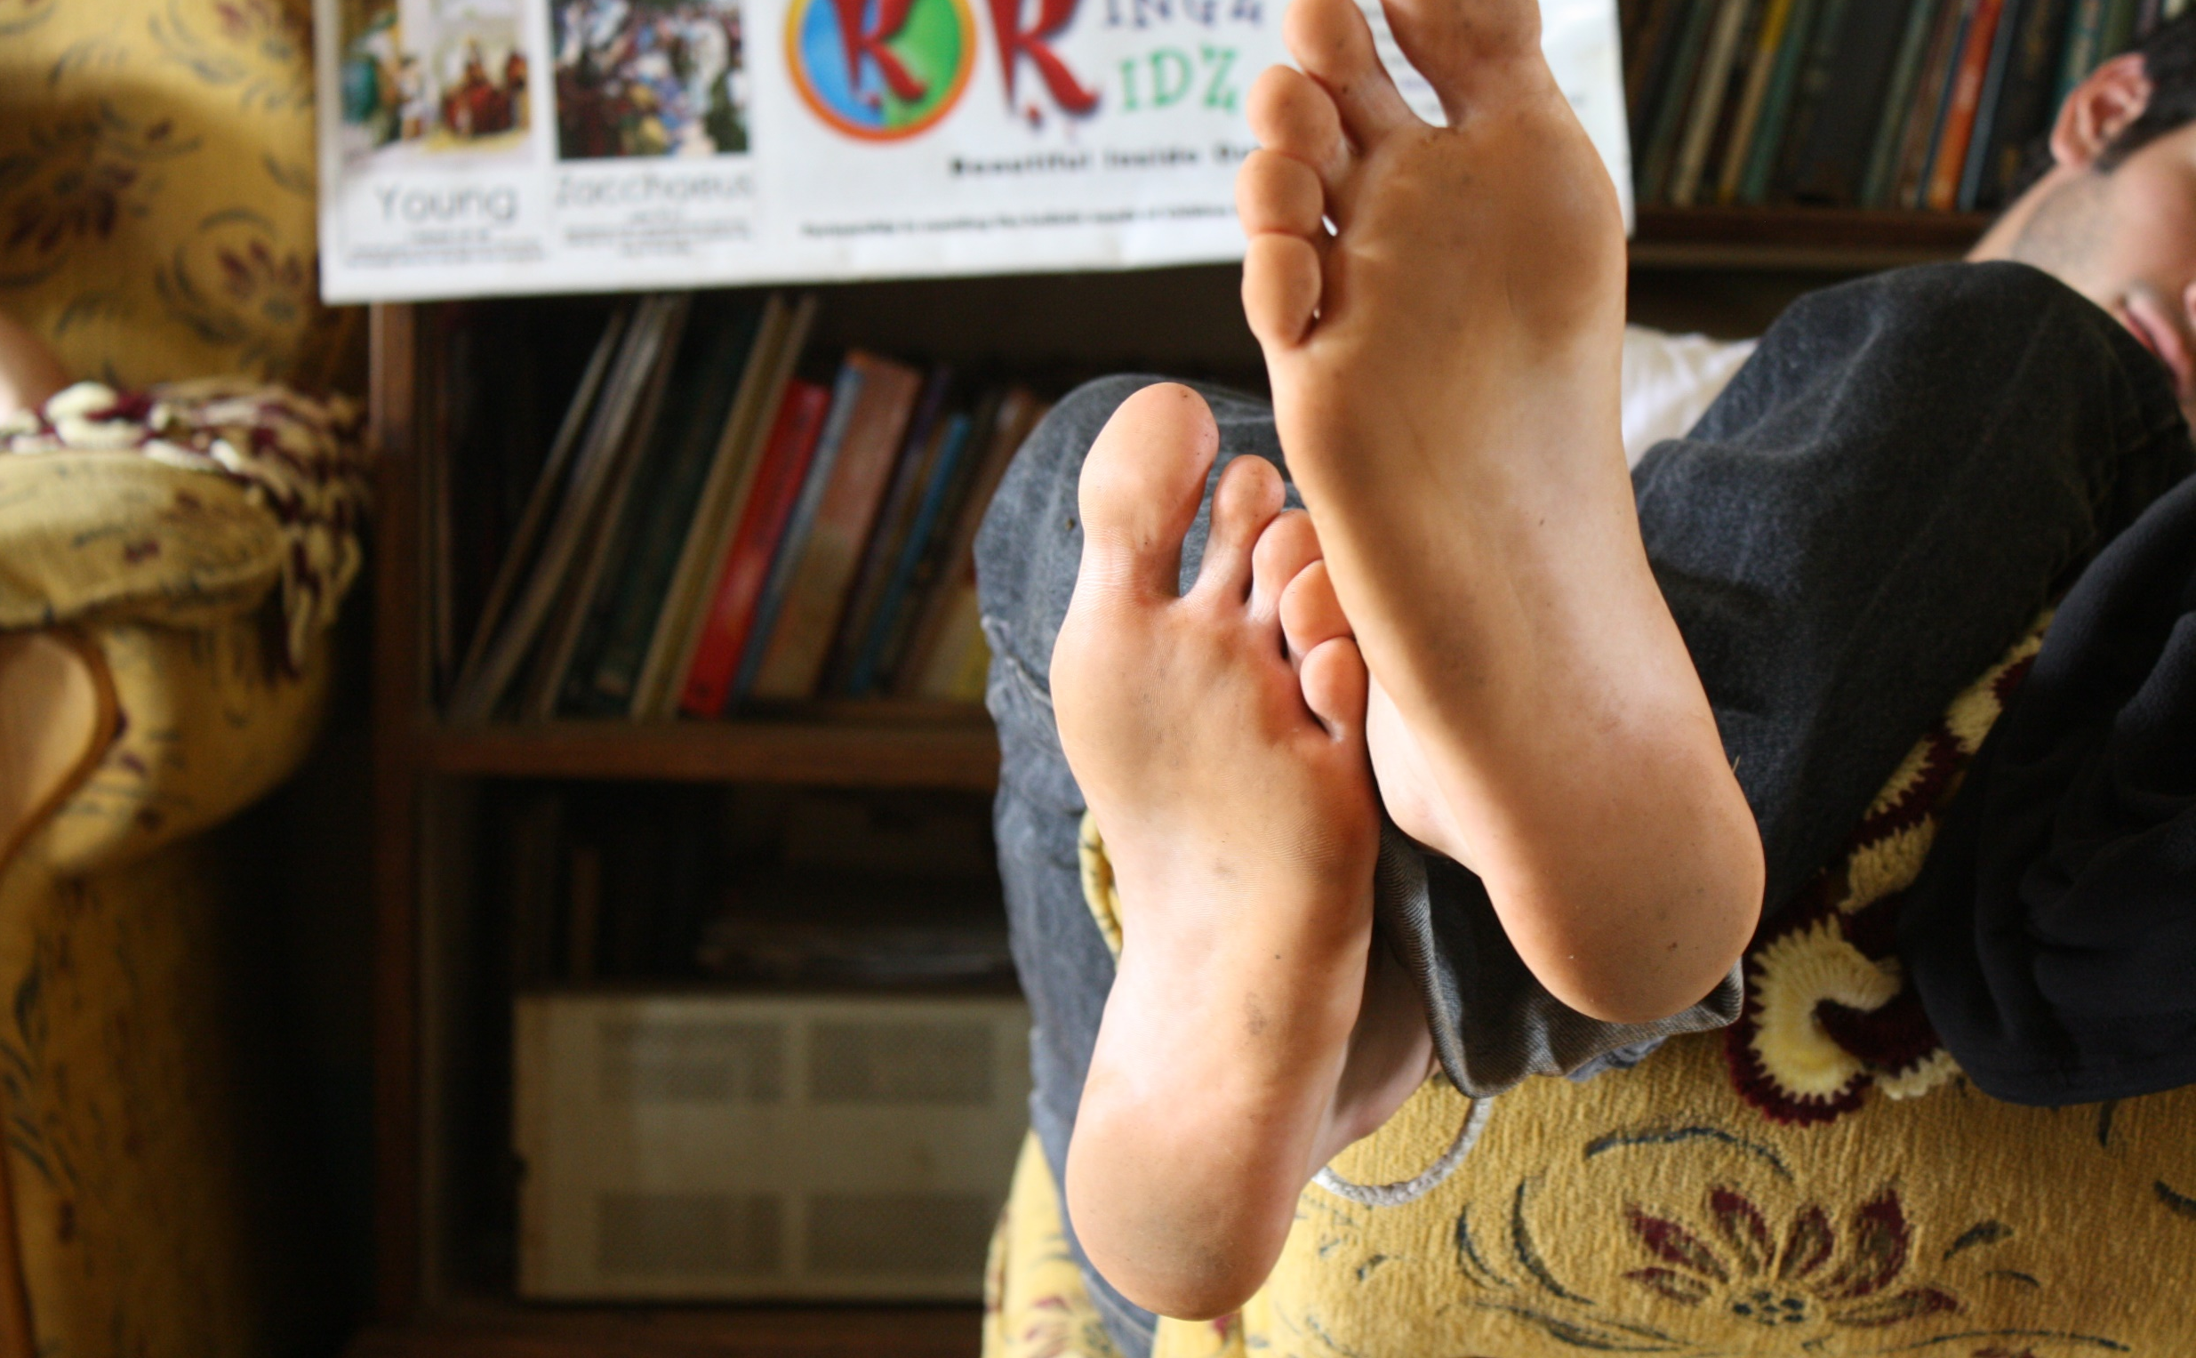
So who needs to get their act together?

Slide 6
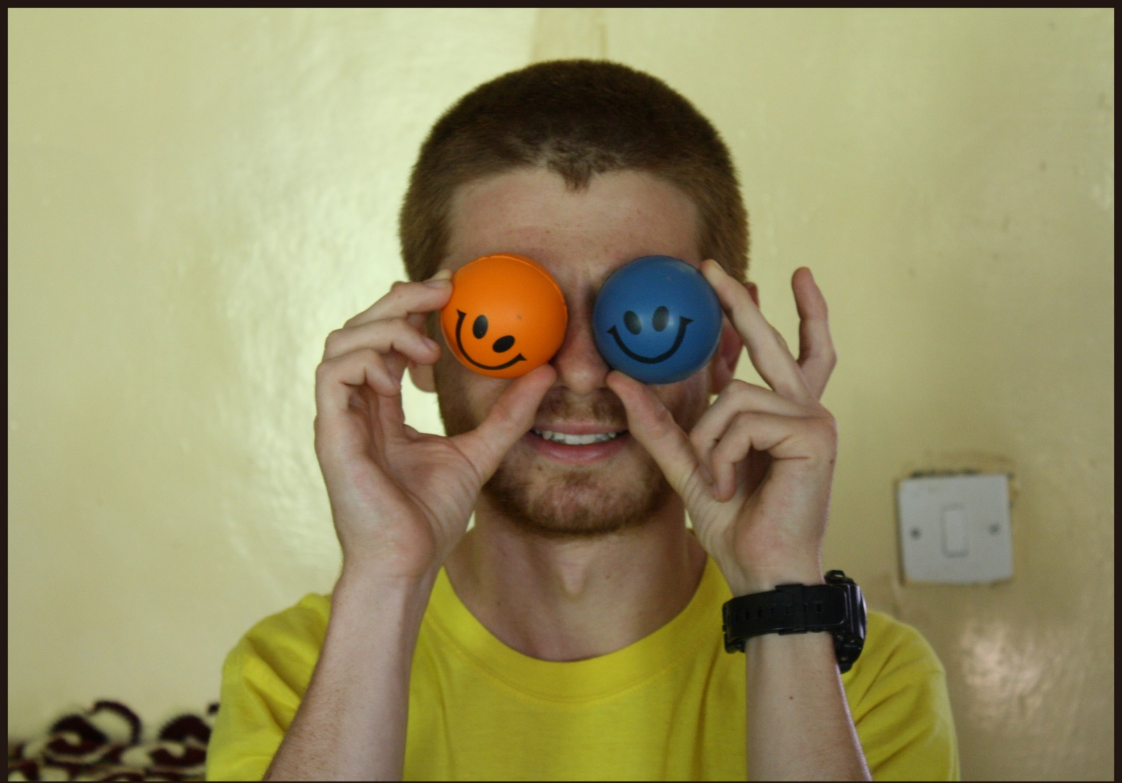
As leadership we need
The Lord’s
Clarity,

Slide 7
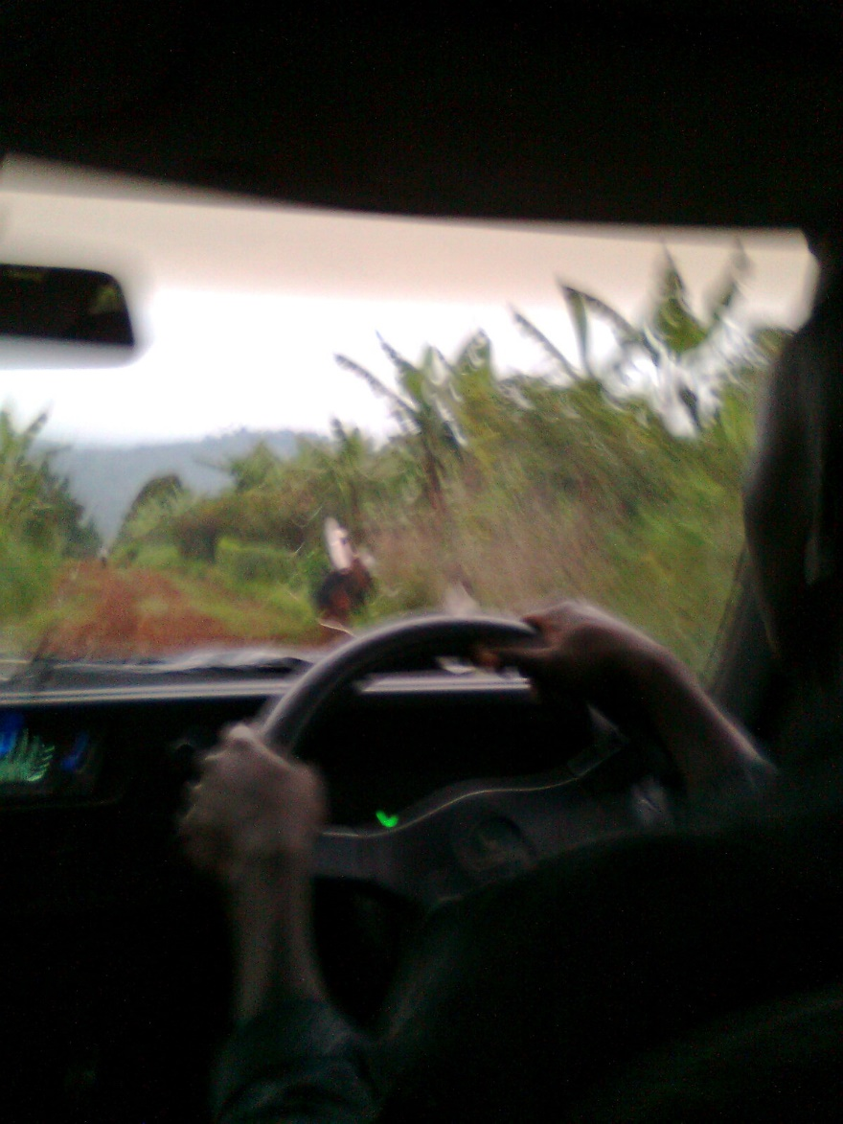
…
Vision

Slide 8
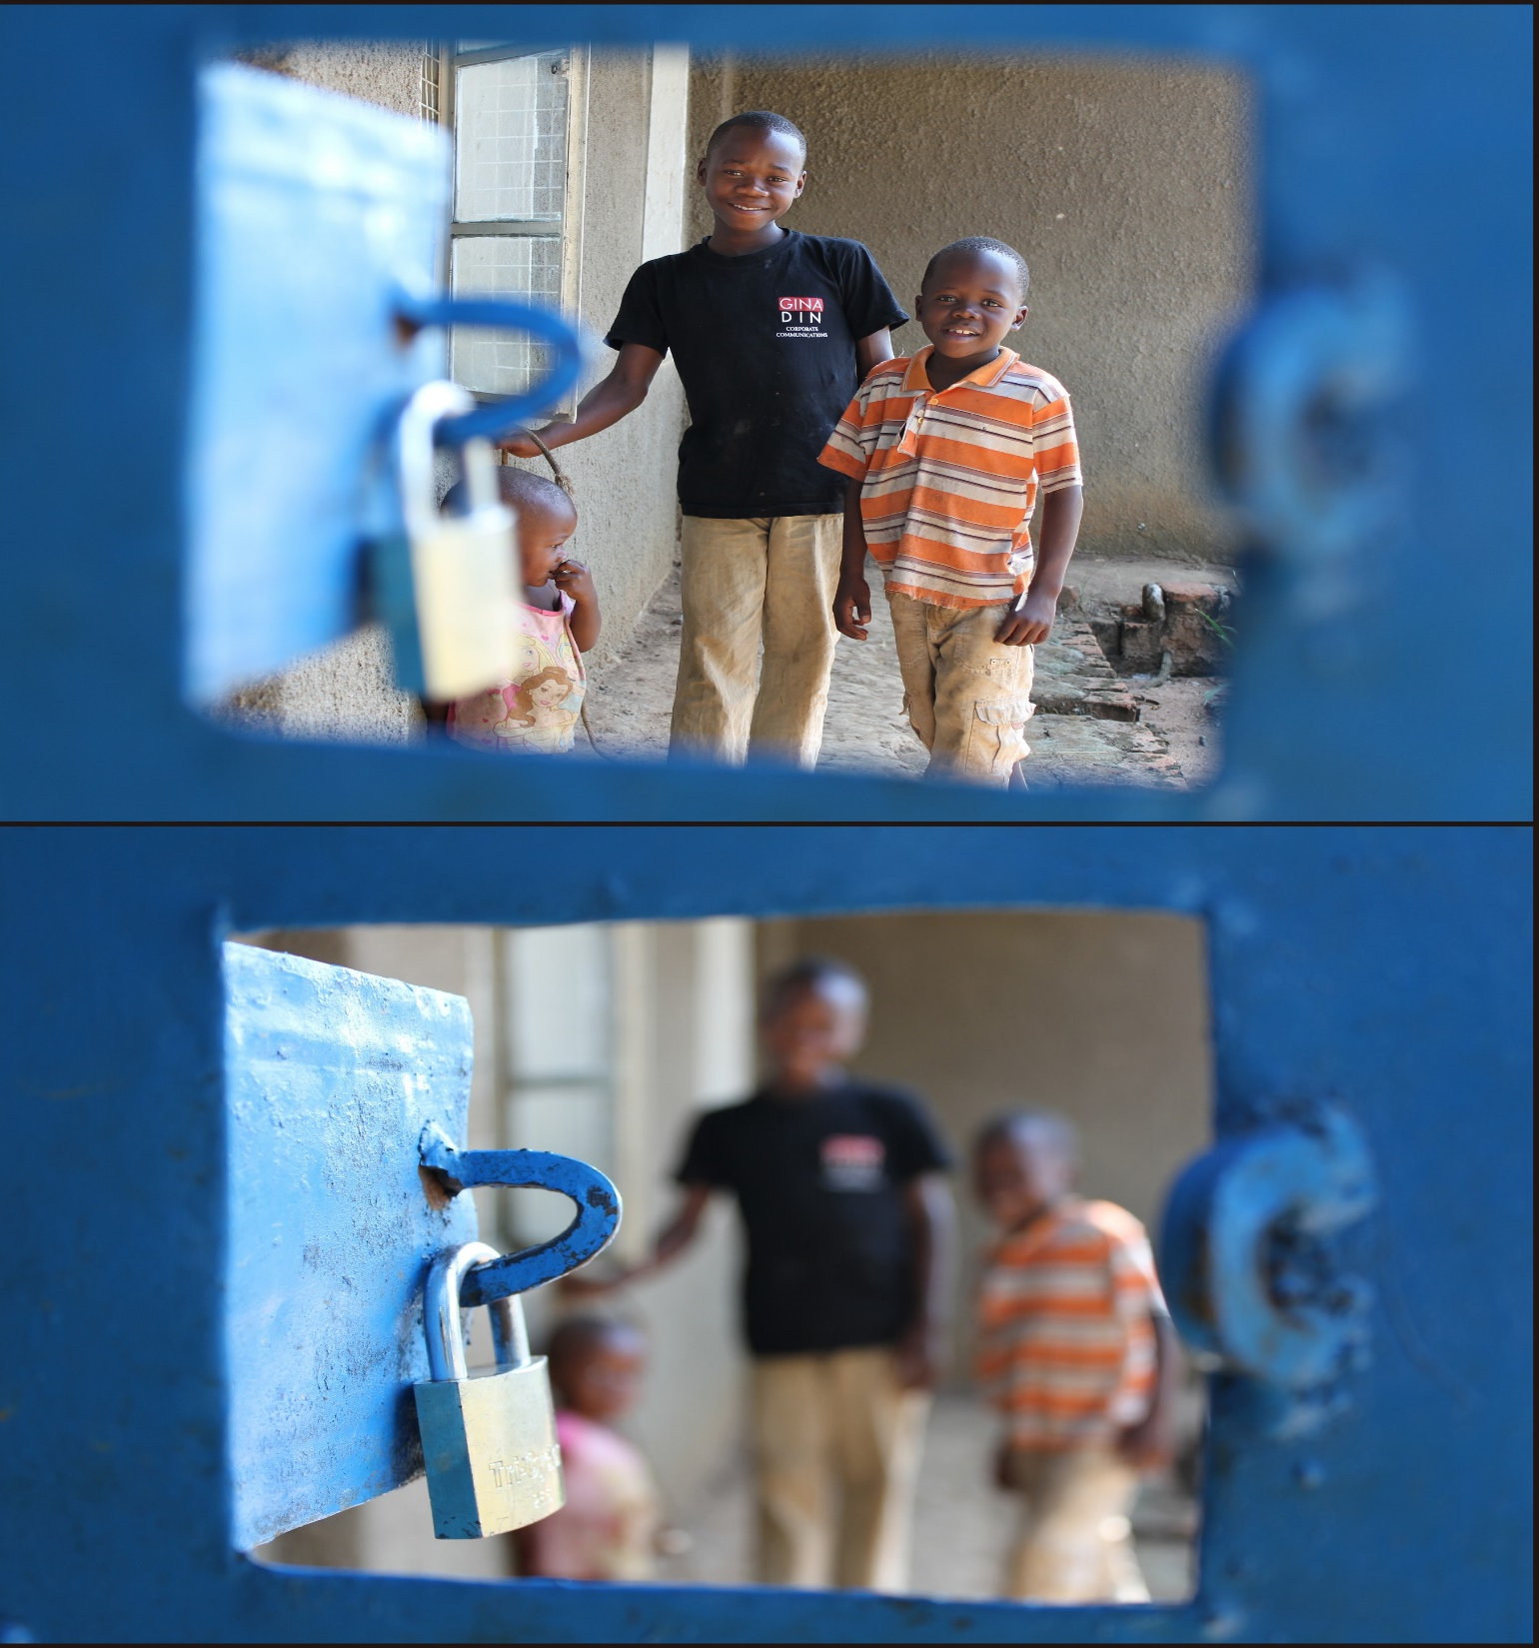
Focus

Slide 9
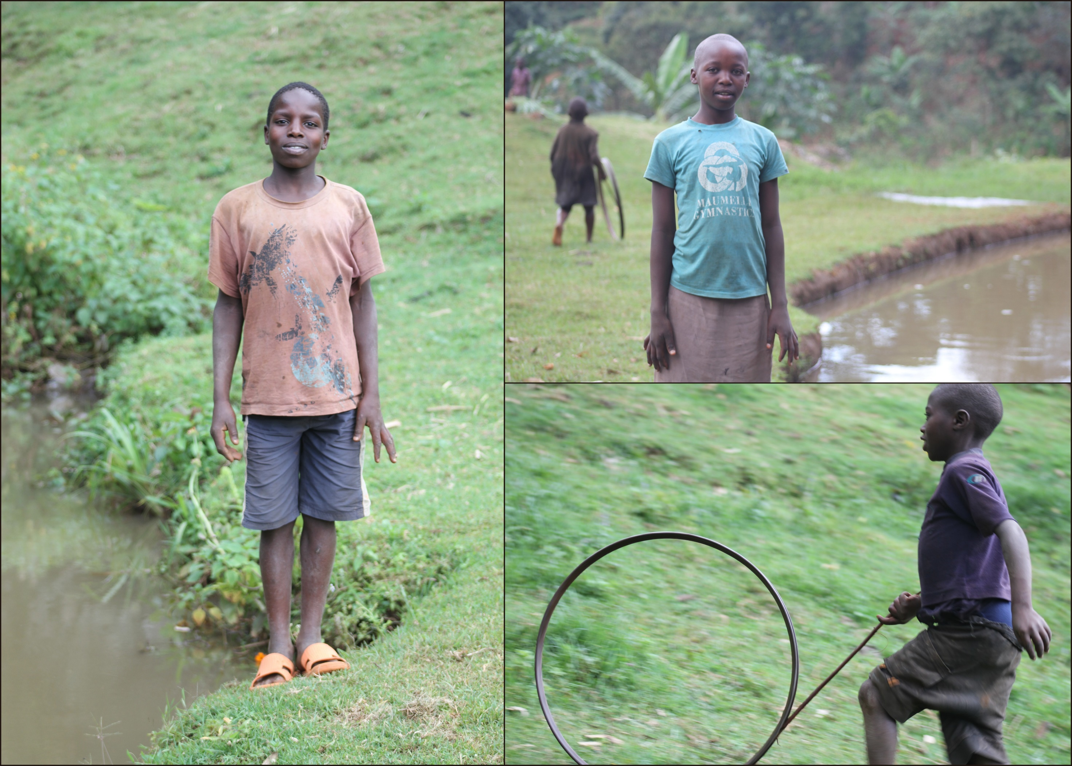
Messianic leadership needs to
Direct the energy and desire of the youth

Slide 10
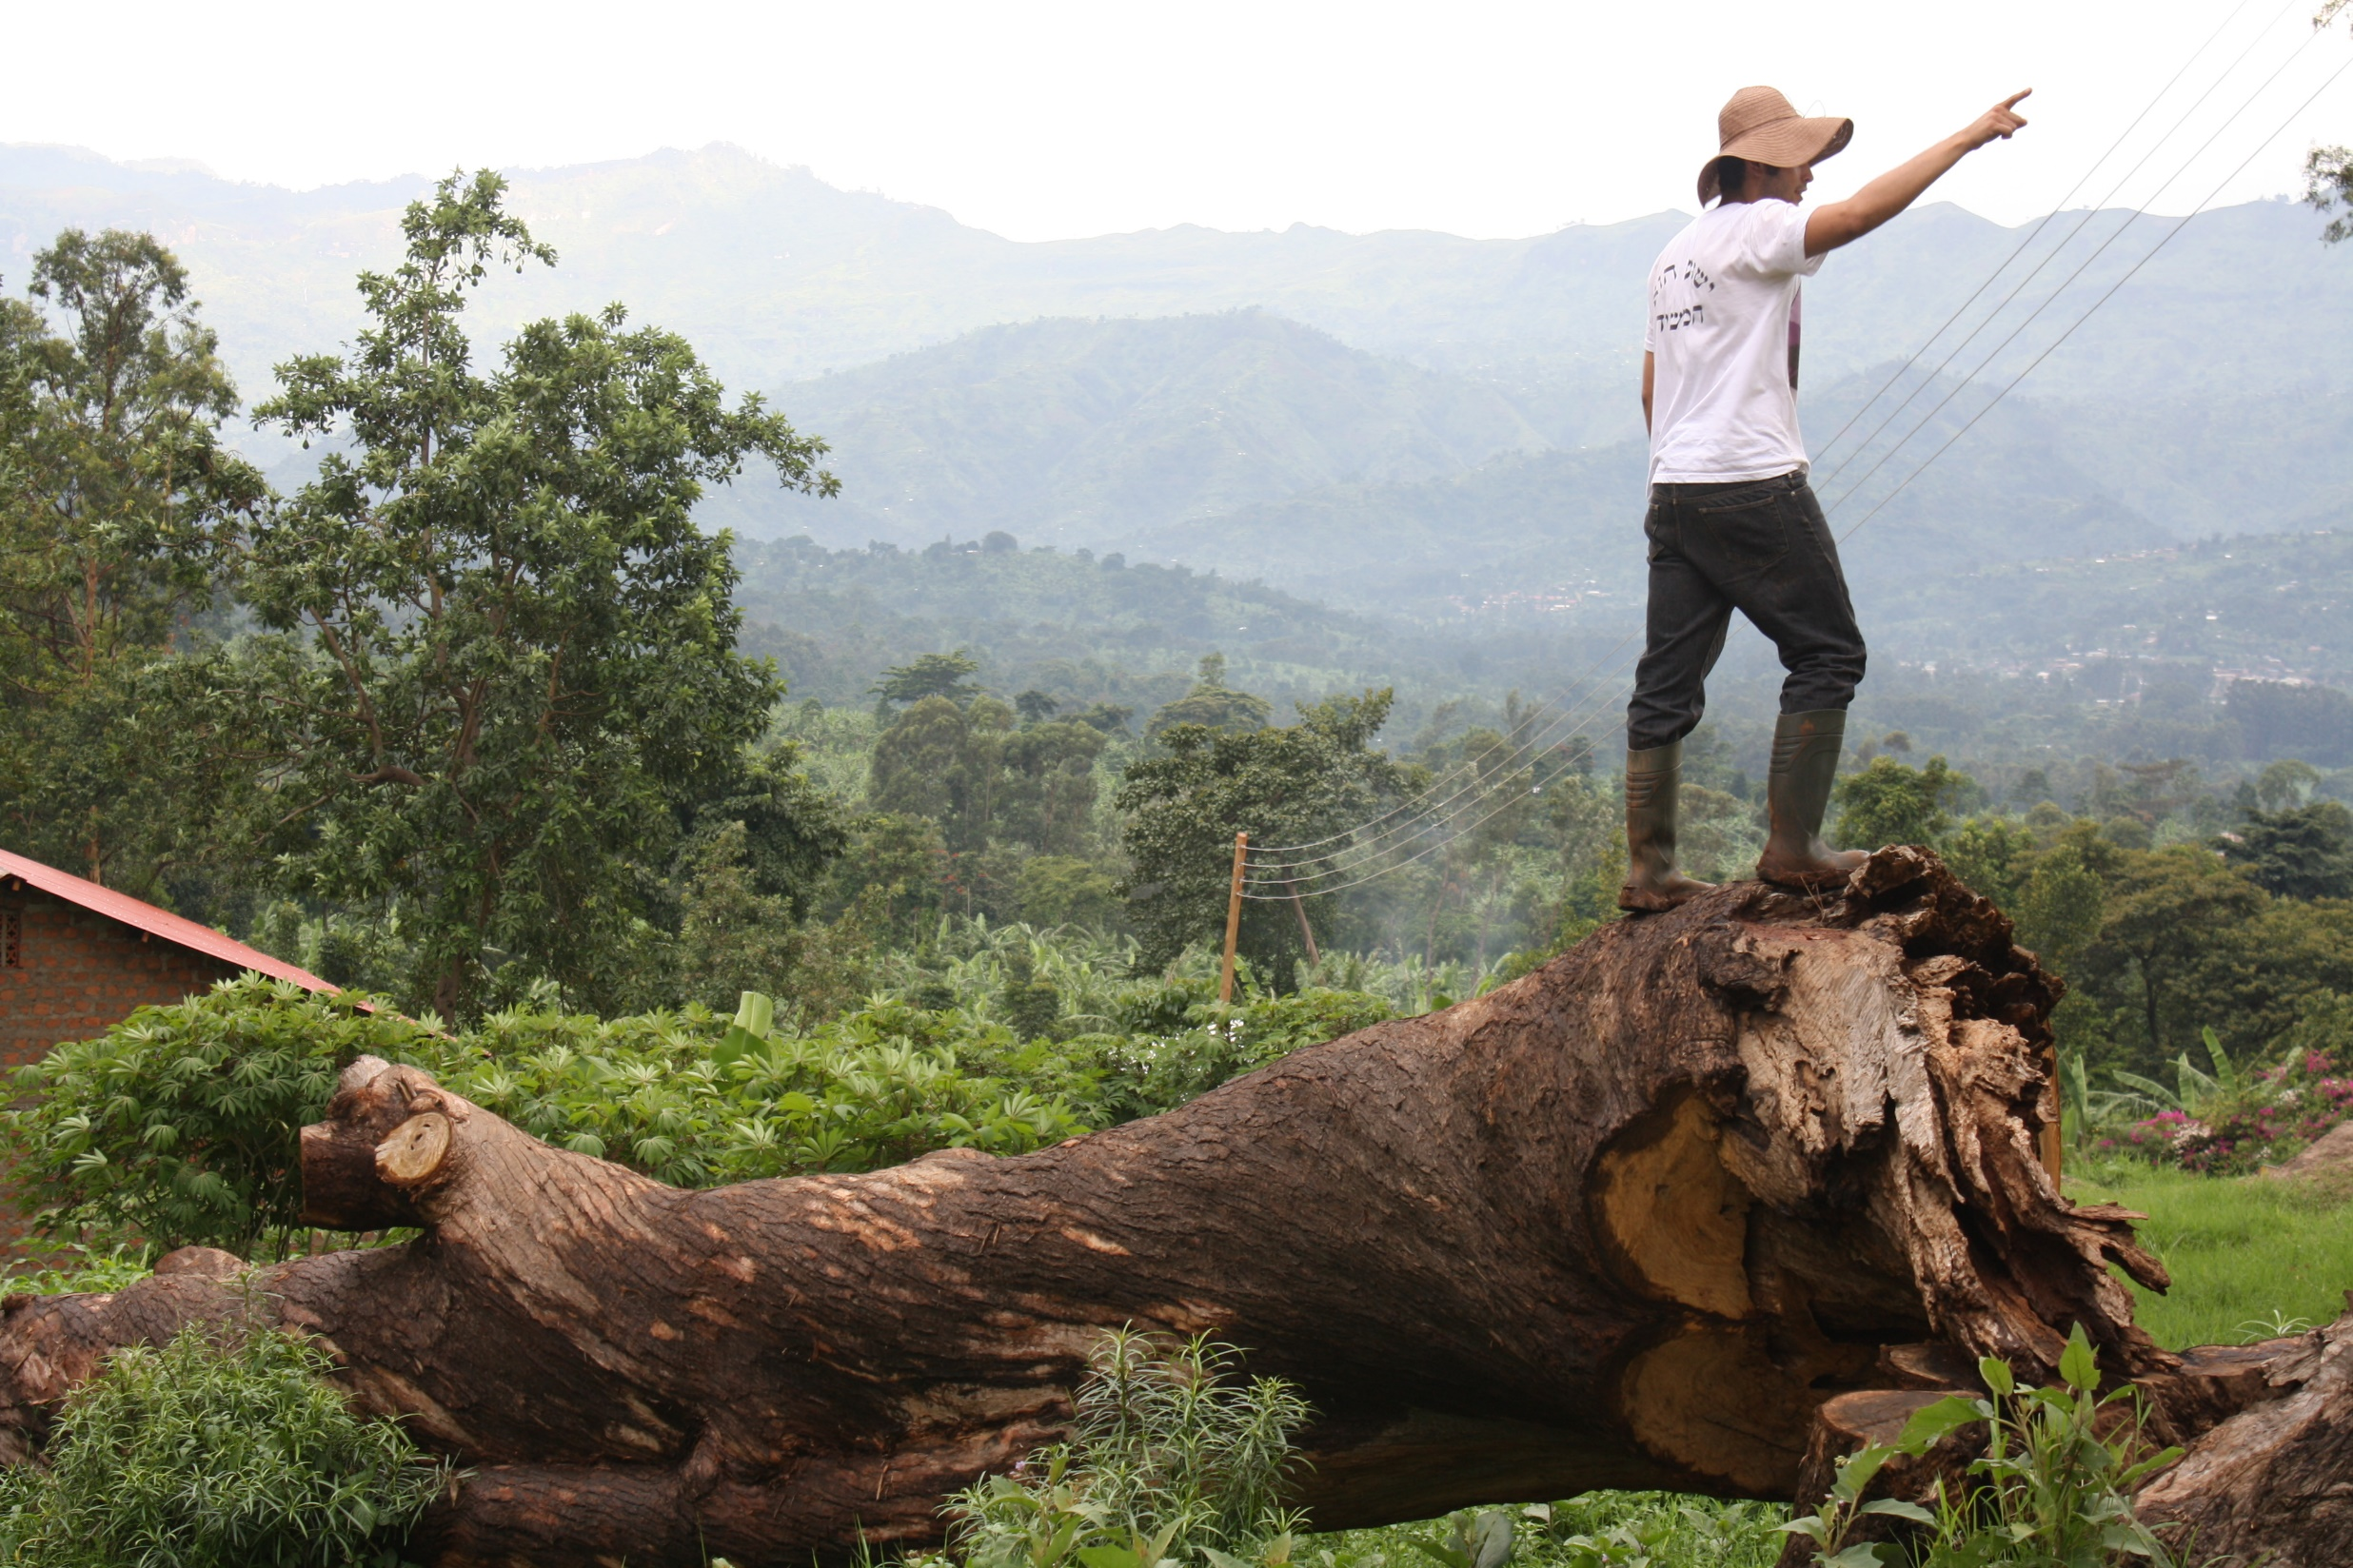
Helping to provide
Direction
Example
Preparation
Teaching
Help
Strategy

Slide 11
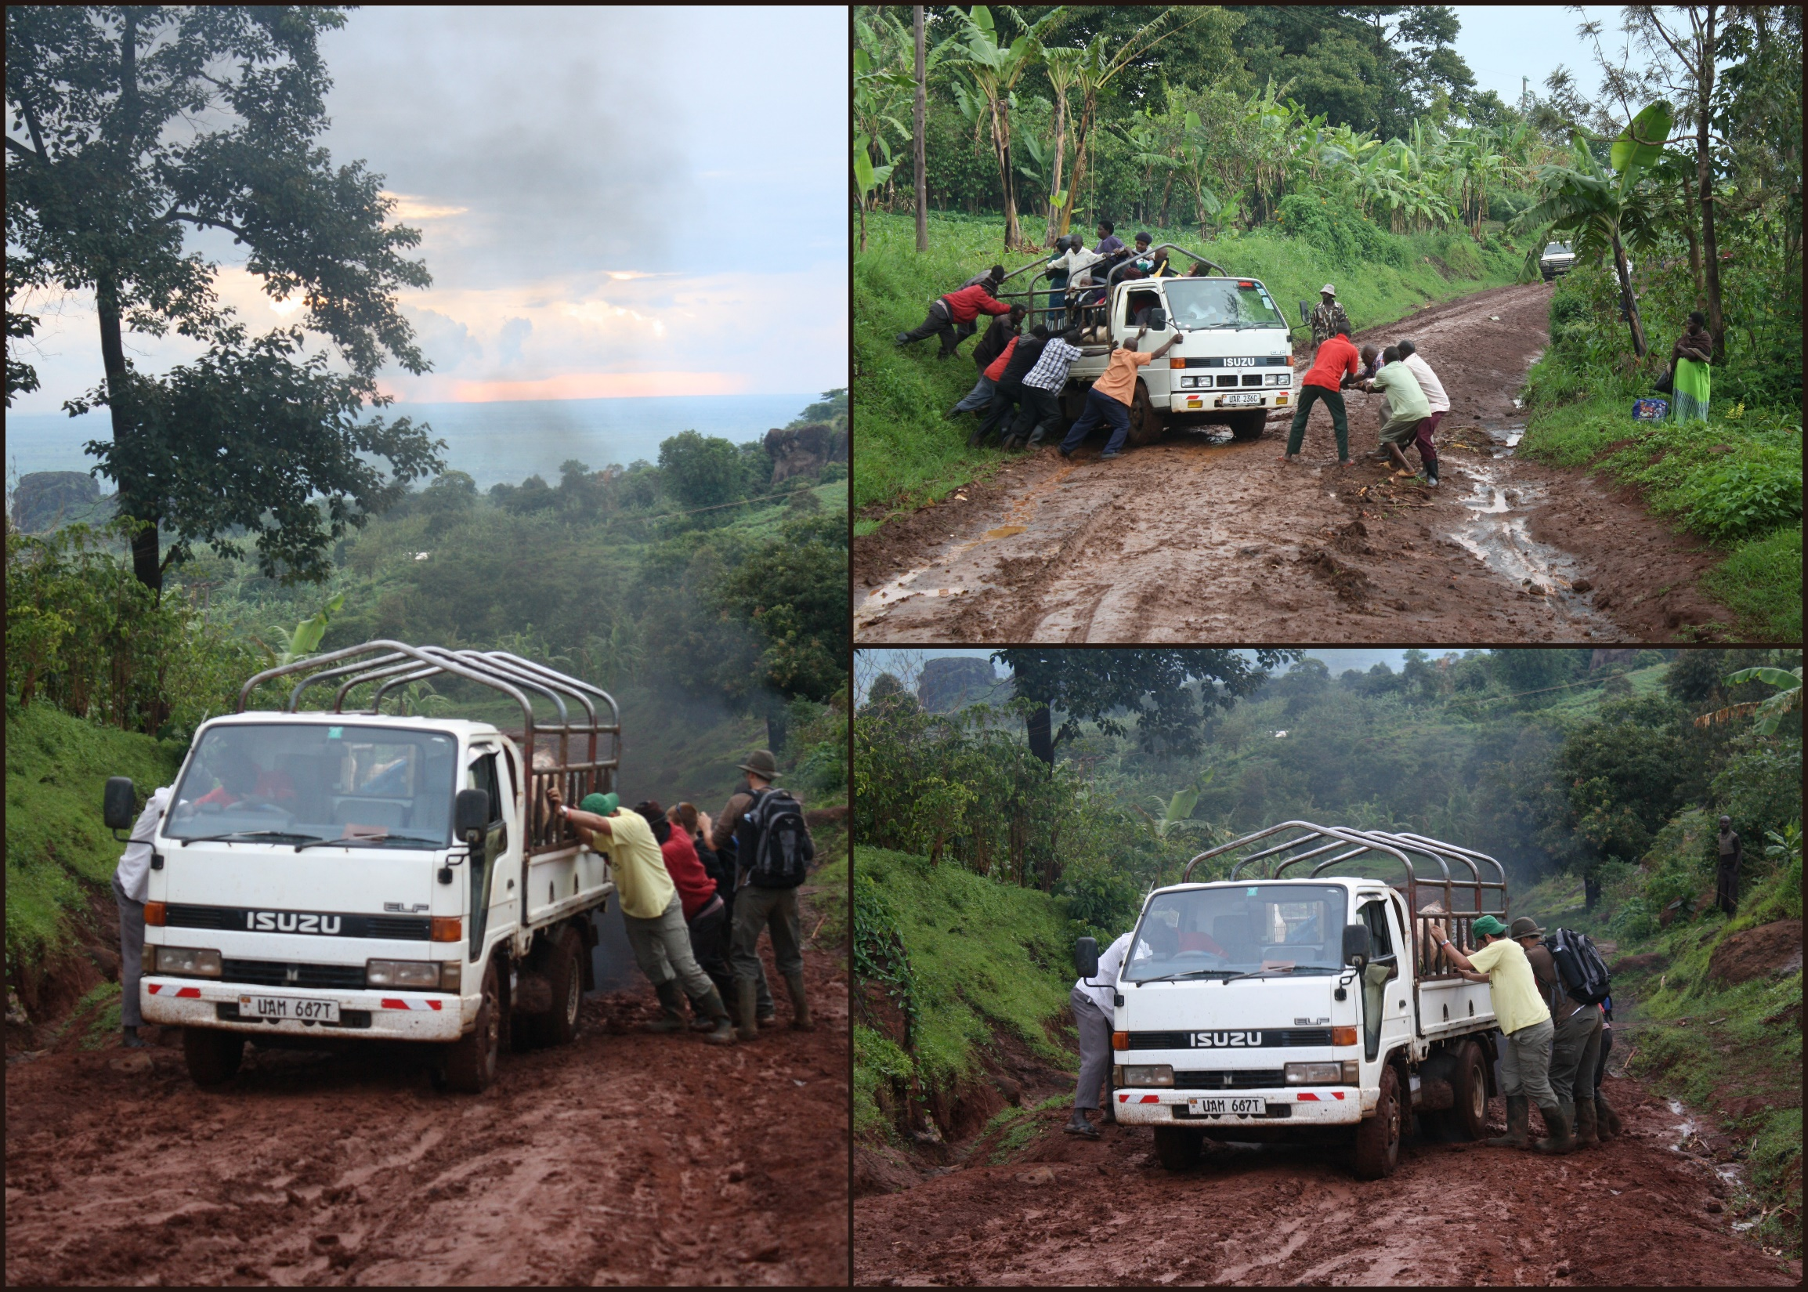
Warning
Short-term mission can be
Self-serving
An exercise in self-gratification
And a burden on those you came to serve!

Slide 12
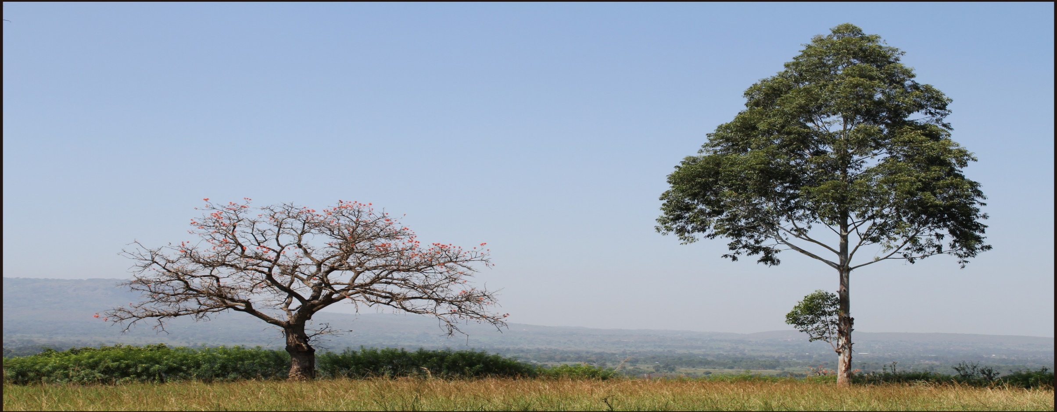
But it can be glorifying to Yeshua
And bring fruit
both
for those you come to serve
and in the life of the Messianic youth who go

Slide 13
So what is our motivation for short-term mission?
And what are our priorities to be?
And how do we make it meaningful?

Slide 14
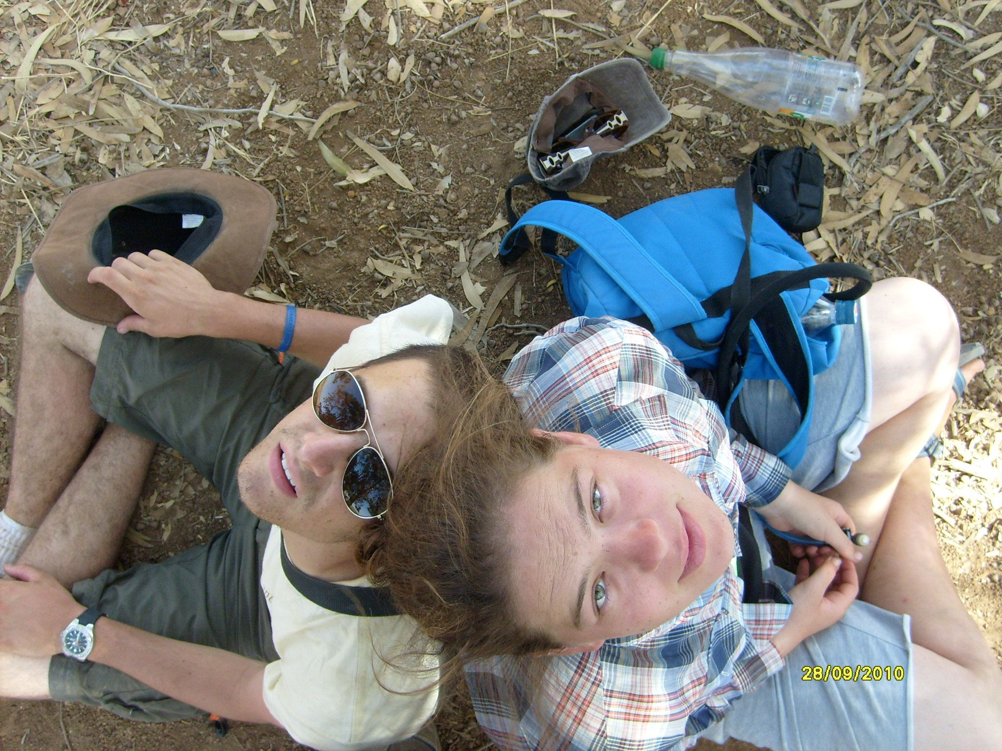
Look up -
to Yeshua
God

Slide 15
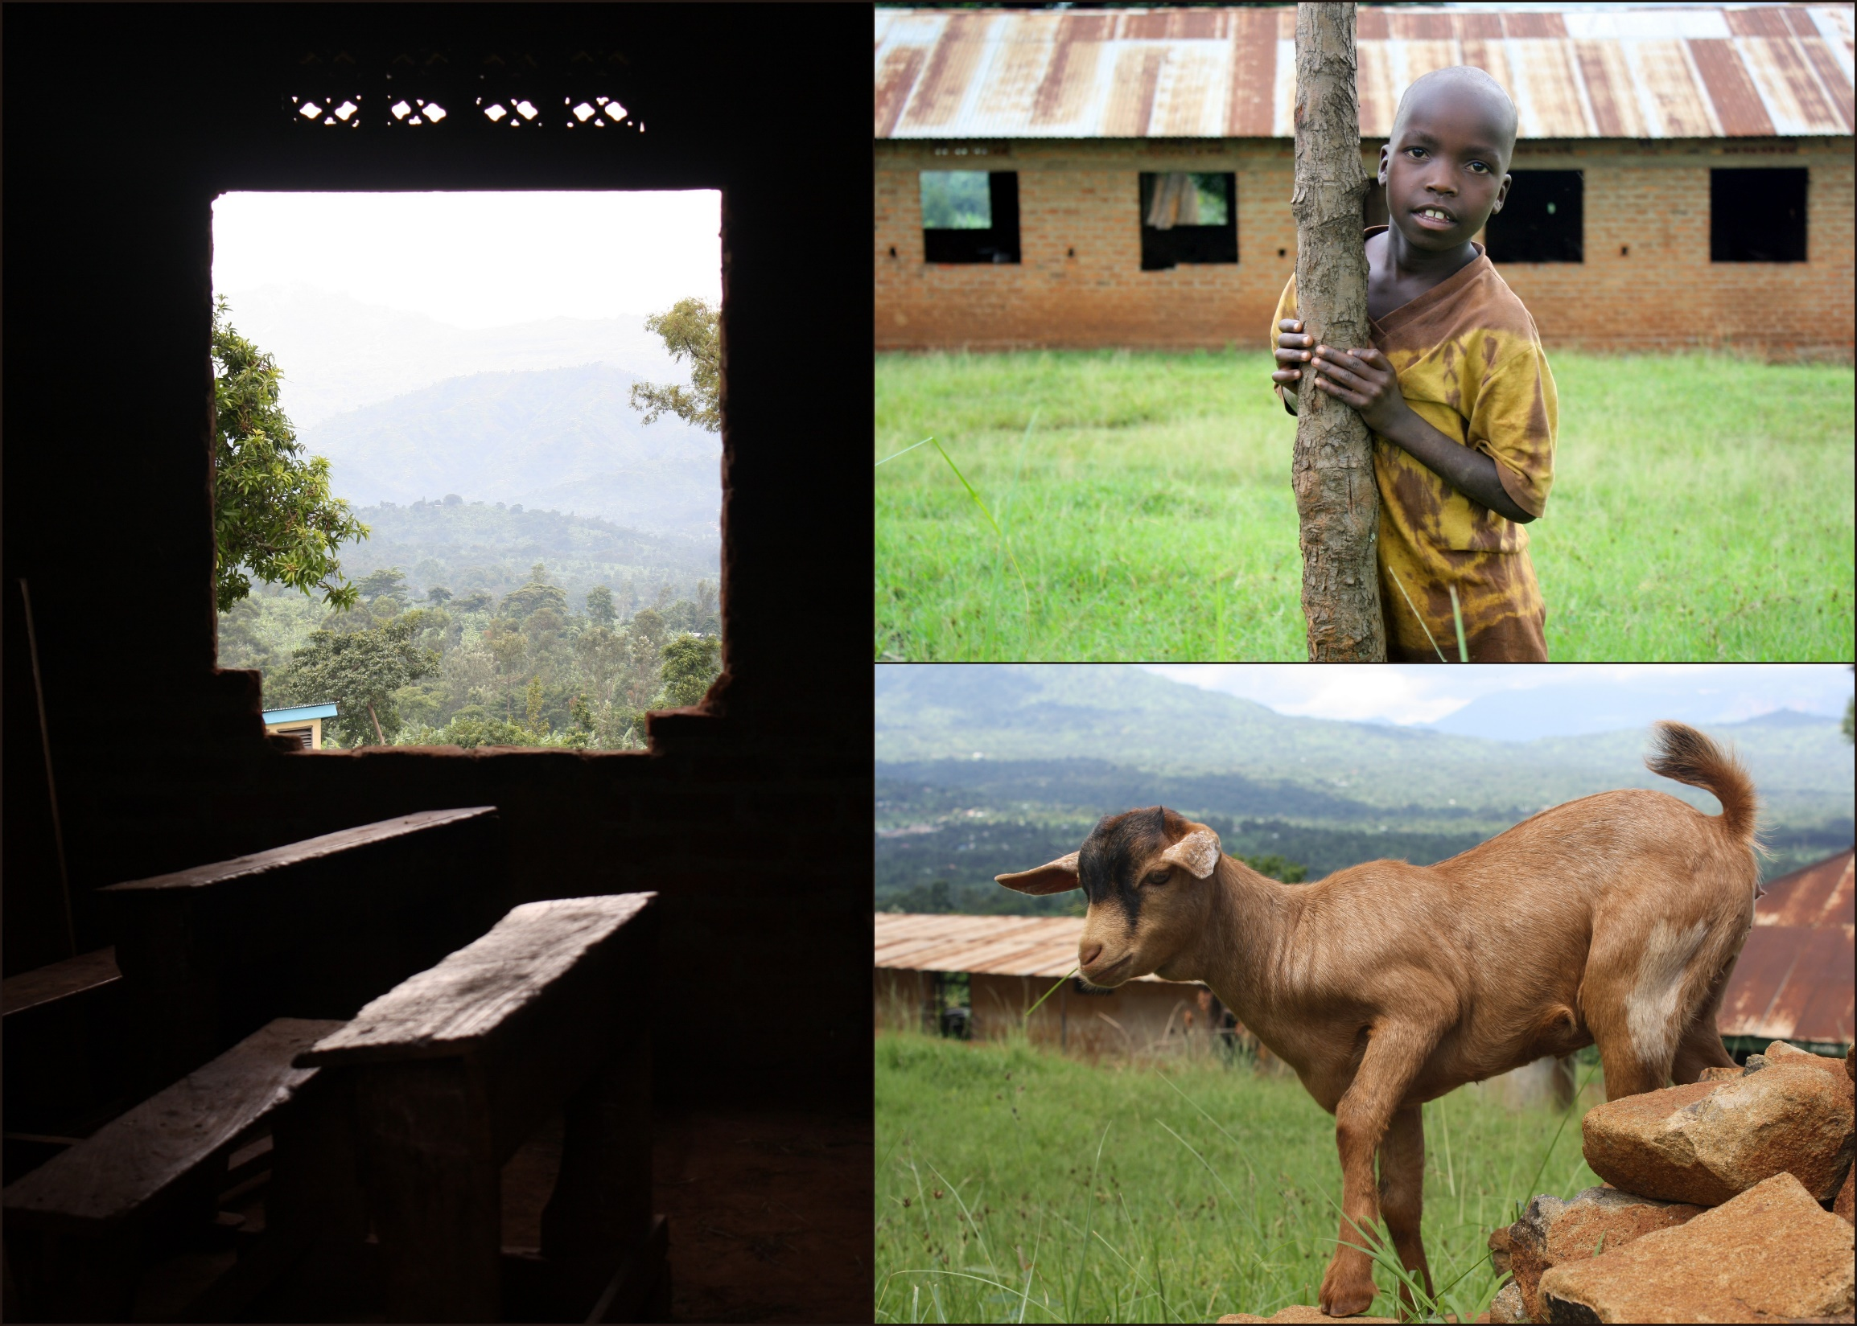
The story of Jonah
and
its importance
for Israel and the remnant

Slide 16
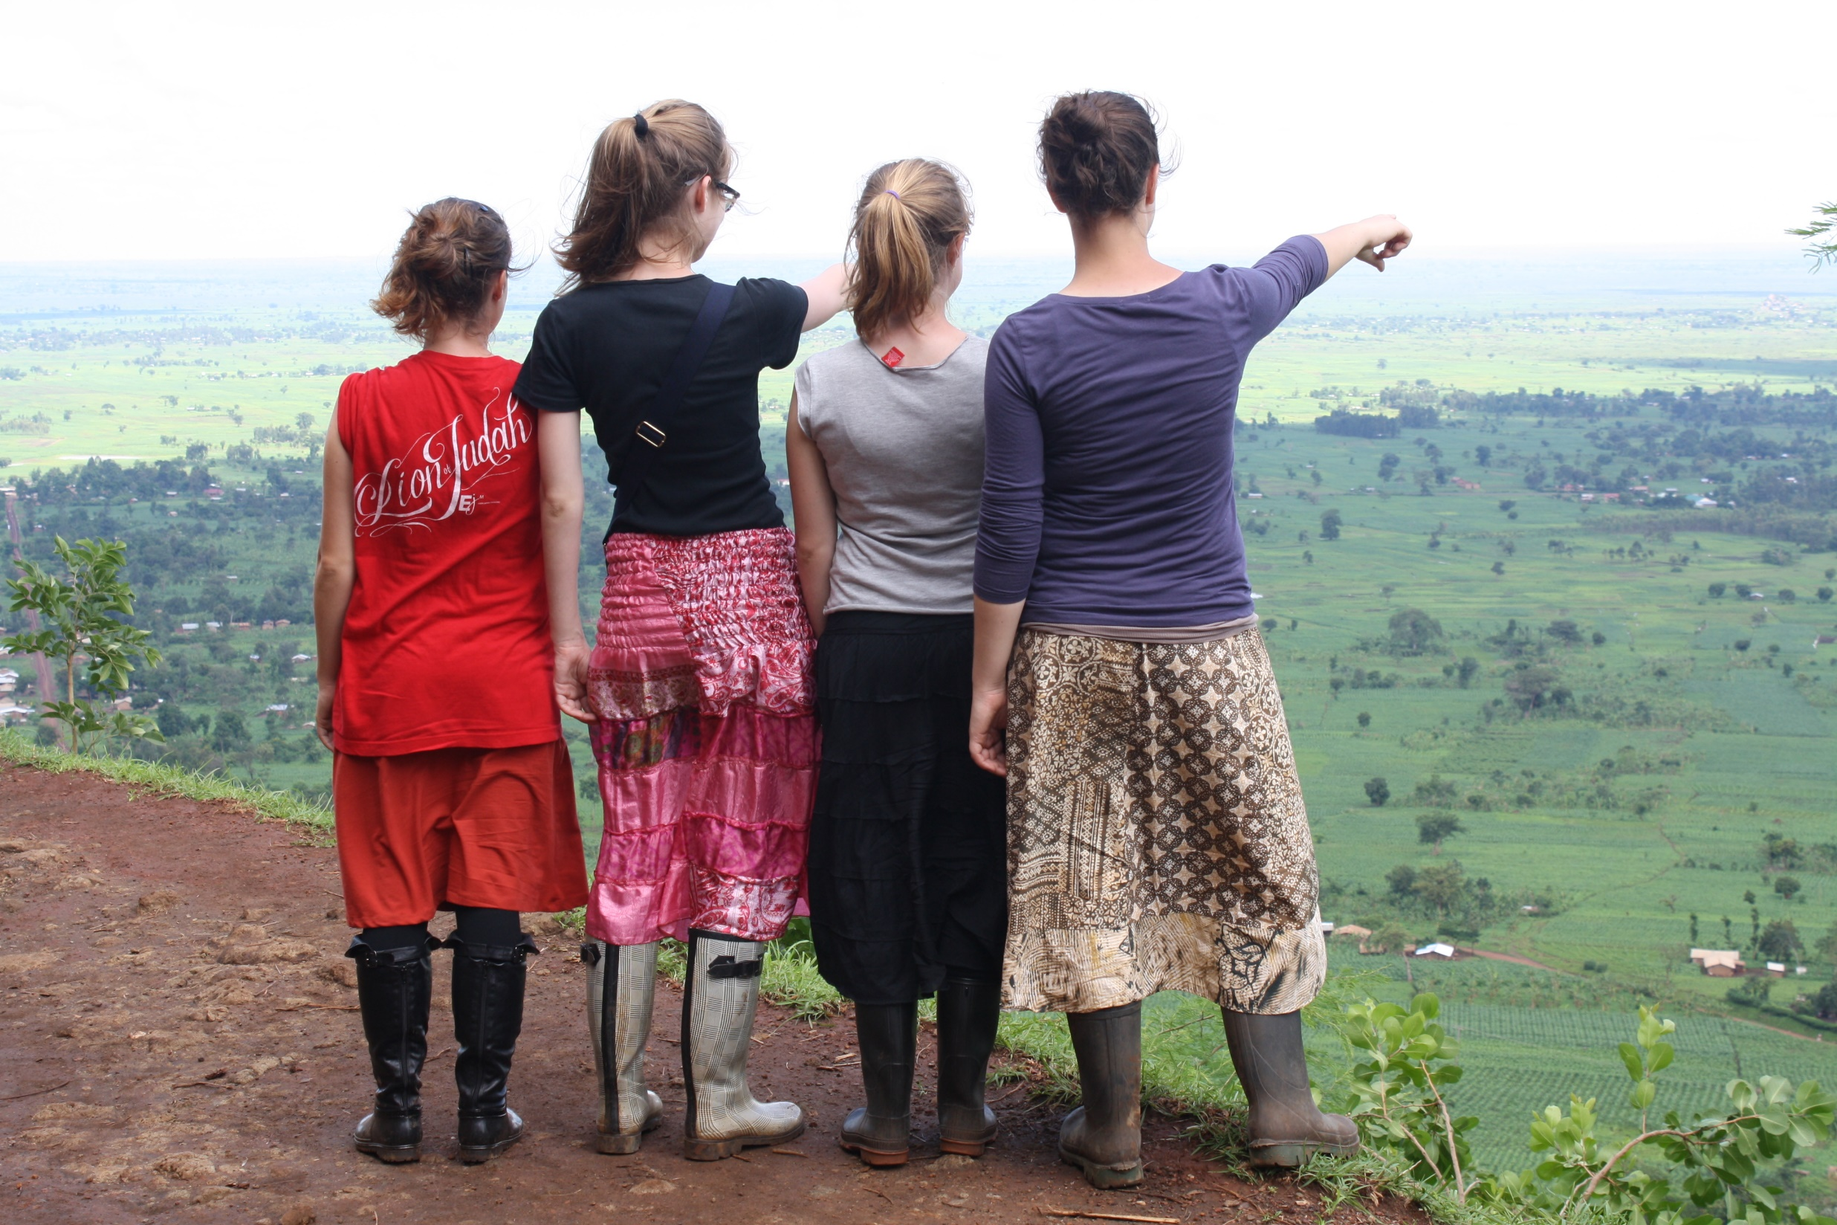
Look out – and give
God
others
“Lech L’cha”, “Lech acherai”
“Go forth” “Follow Me”

Slide 17
Two truths going hand-in-hand
Both important in the discipleship of Messianic youth:
1/ the calling and role of the remnant
2/ the unity of the body of the Messiah

Slide 18
The best context for short-term mission
is
Long-term relationship

Slide 19
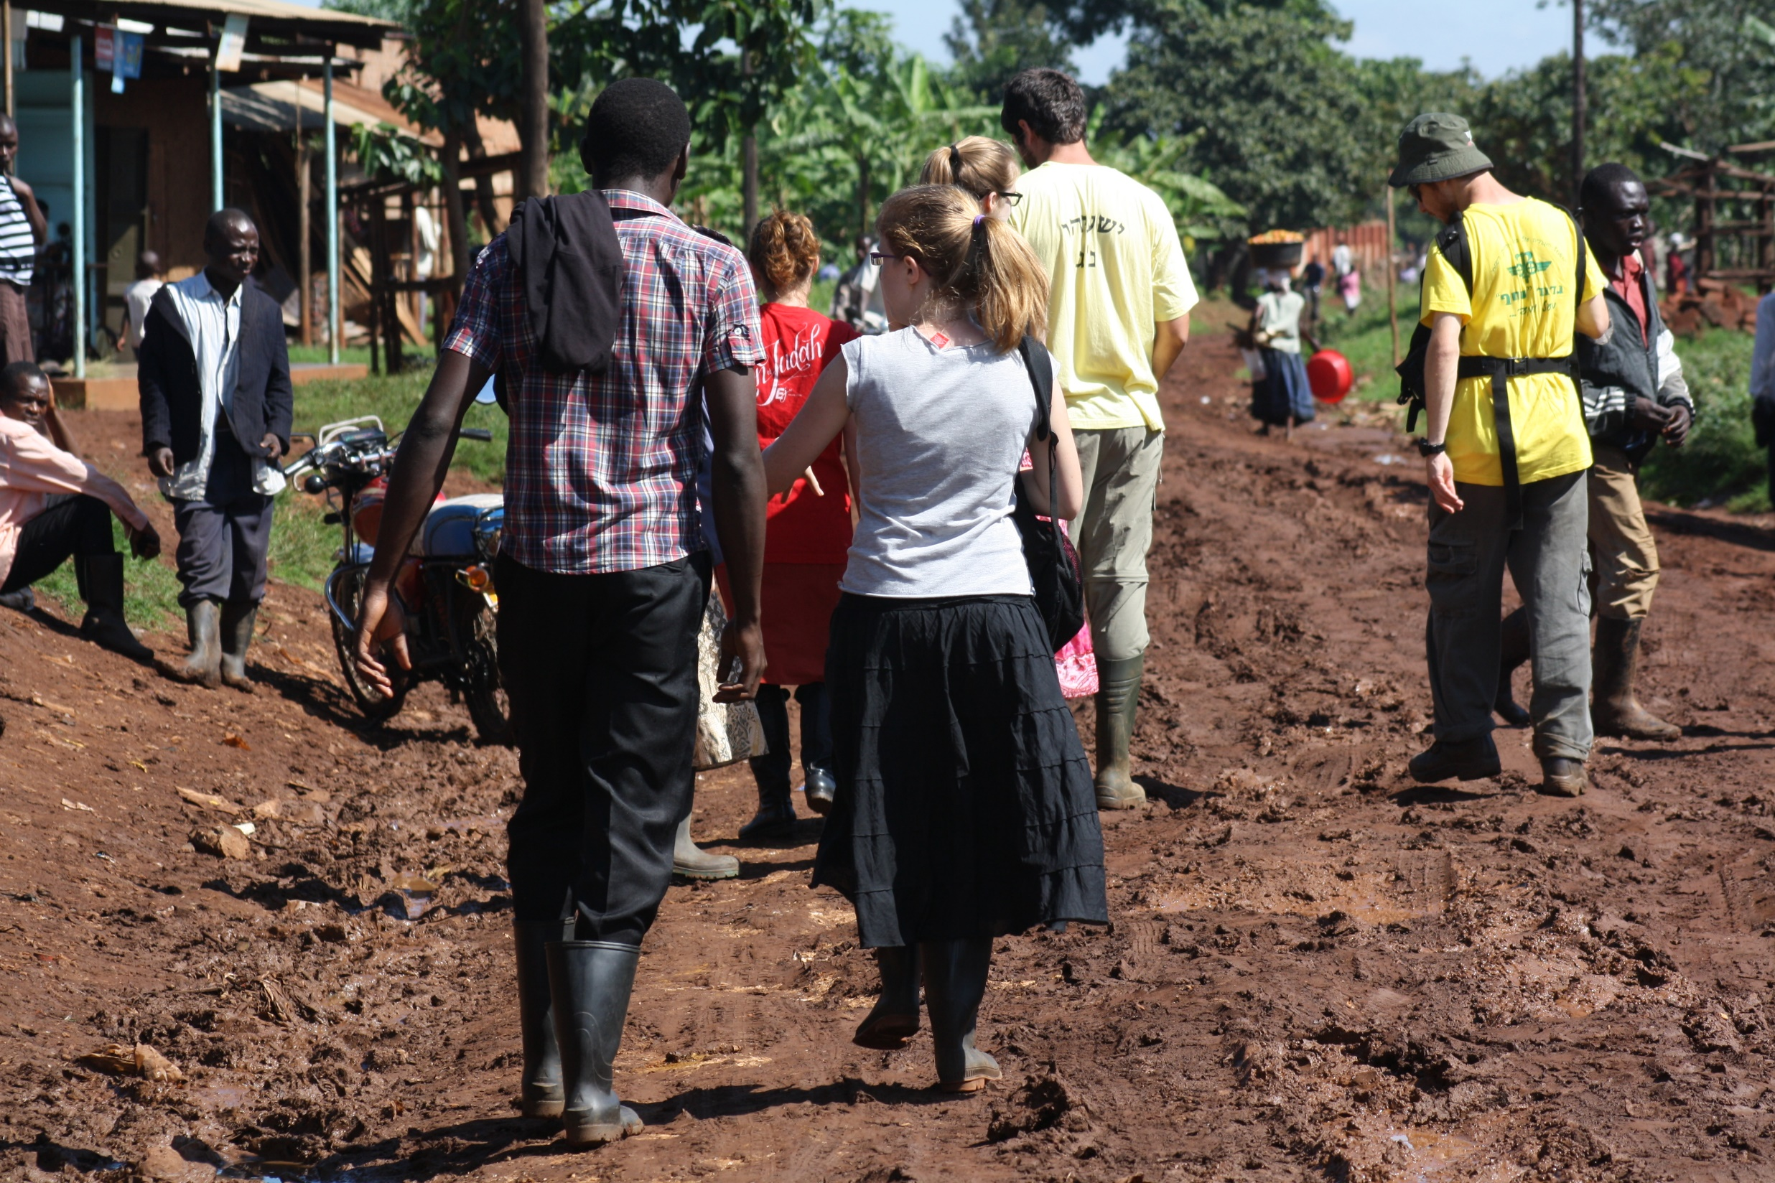
Each group that goes has a value in itself
but also
Becomes a step in building a long-term relationship in which we get to know one another and serve together.
Walking together through sunshine and through rain.

Slide 20

And you will flourish
God
others
growth
ourselves

Slide 21
So being part of a short-term mission becomes a part of growing as a disciple of Yeshua

Slide 22
Some questions to end with:

Slide 23
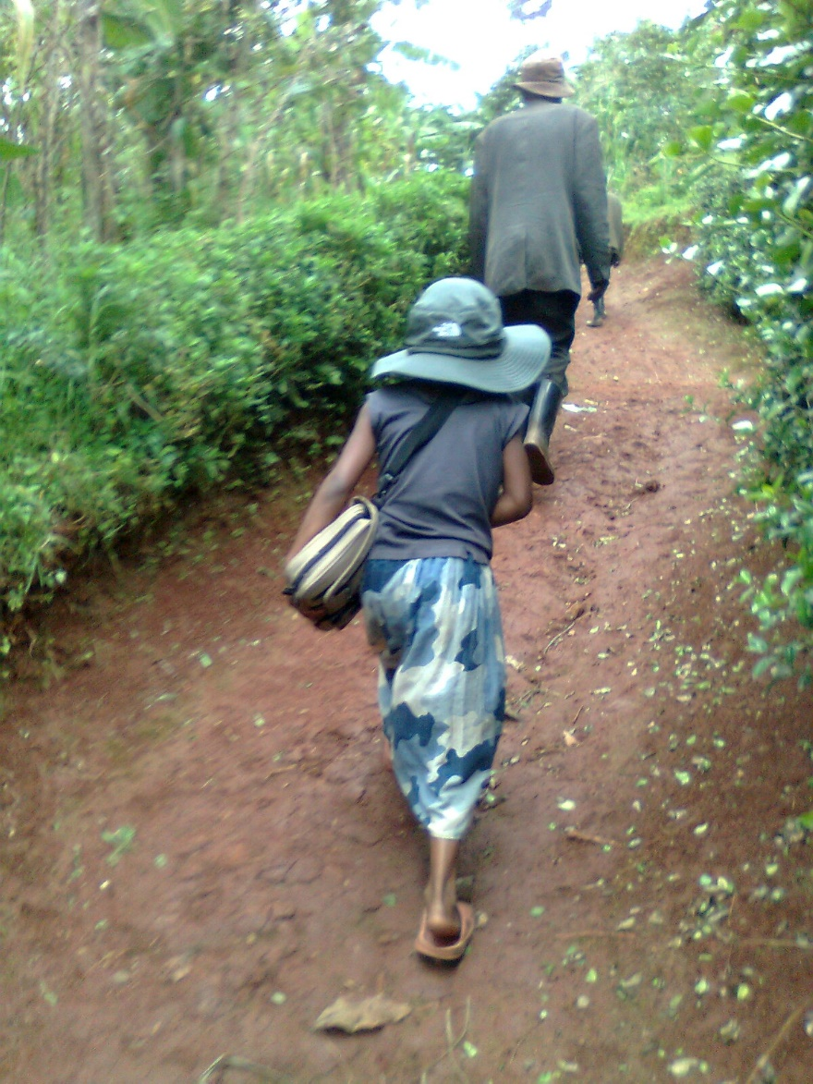
How do we mobilize the youth?
(by explanation
or
by example?)
How do we lead?
( from the fore or from the rear?)

Slide 24
When will we replace ‘short-term’ with ‘long-term’?

Slide 25
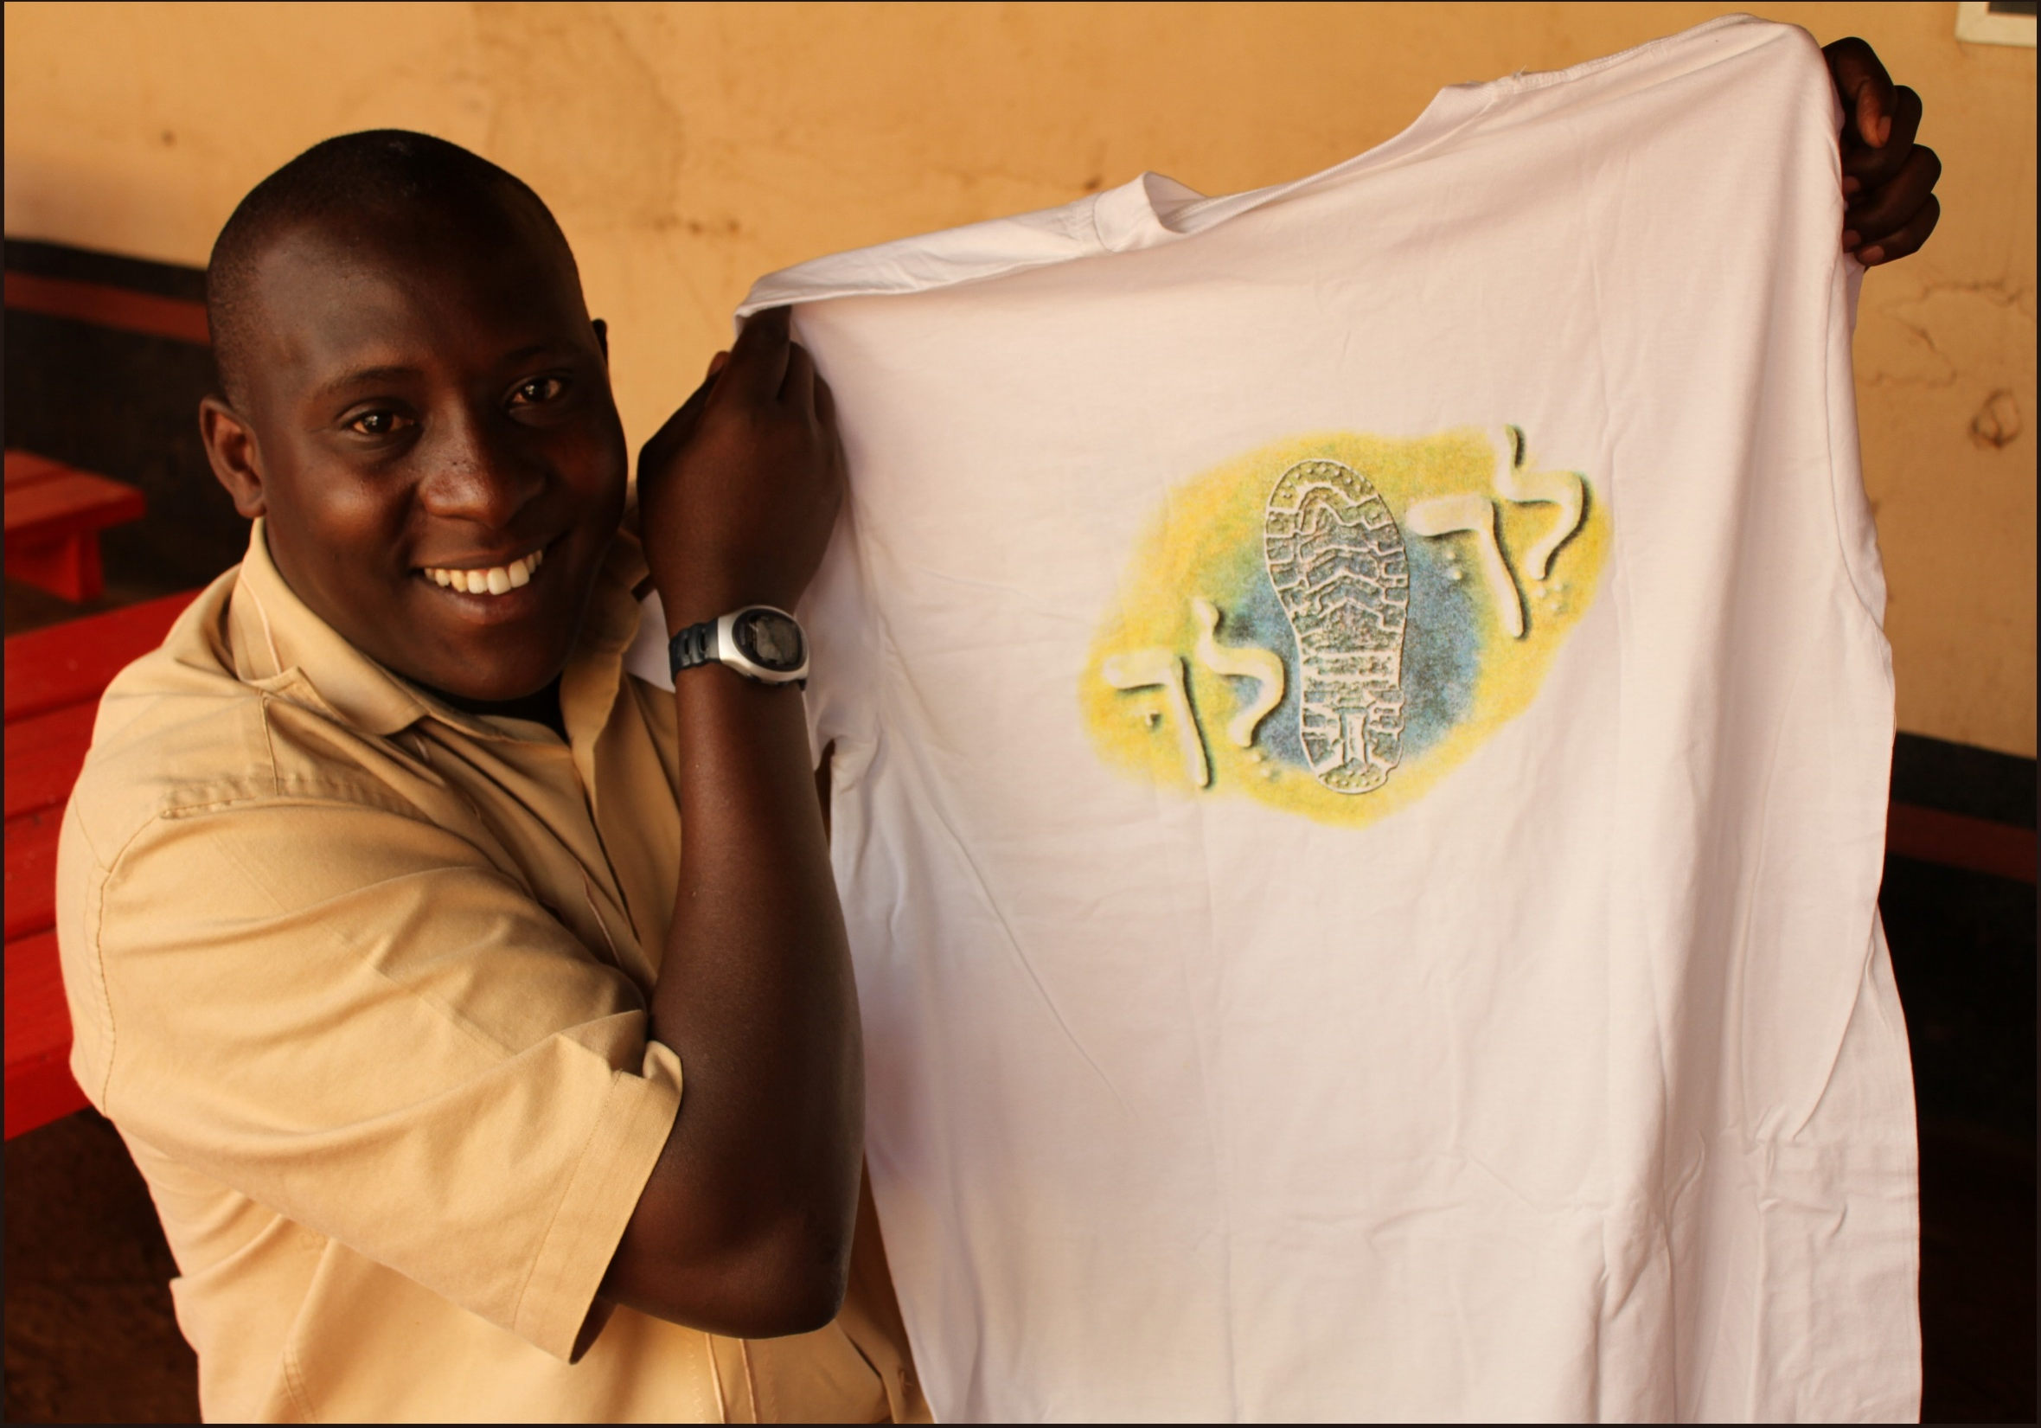
Go forth…
“It is better to give than to receive!” Yeshua the Messiah

Slide 26
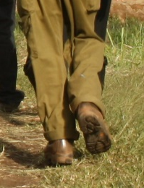
God
Others
Formative
Ourselves
Relationship
Teach
Hallel
Giving
Outward looking
Fruitful
Open
Relevant
Teachable
Humble

